Slide 1
Health through the Microscope

Slide 2
Day 1
What do you think of when you hear the word Microbiology?
Microbiology is the study of tiny-living things called microorganisms. These include bacteria, viruses, and fungi. Microorganisms can live pretty much anywhere, in the dirt, in the water, in our food, even in us!

Slide 3
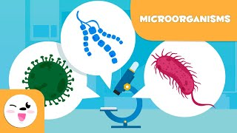

Slide 4
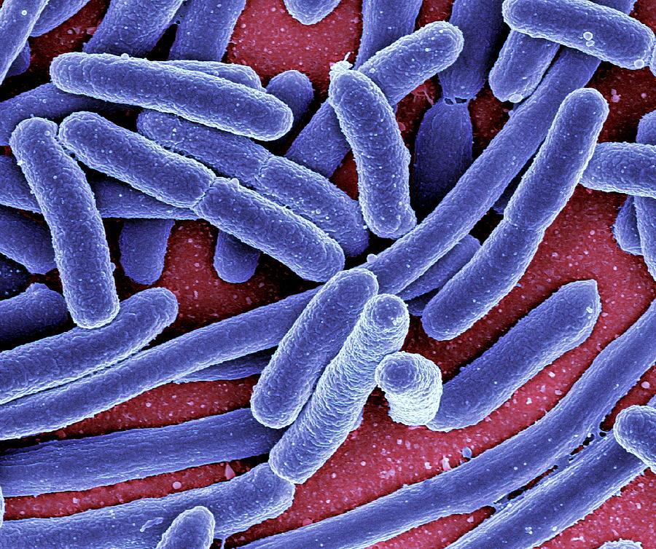
Bacteria
Bacteria are unicellular, they only have one cell
Prokaryotes: have no nucleus and lack most of the organelles found in eukaryotes.
Bacteria also only have 1 circular
chromosome
Bacteria can only be seen through a
microscope

Slide 5
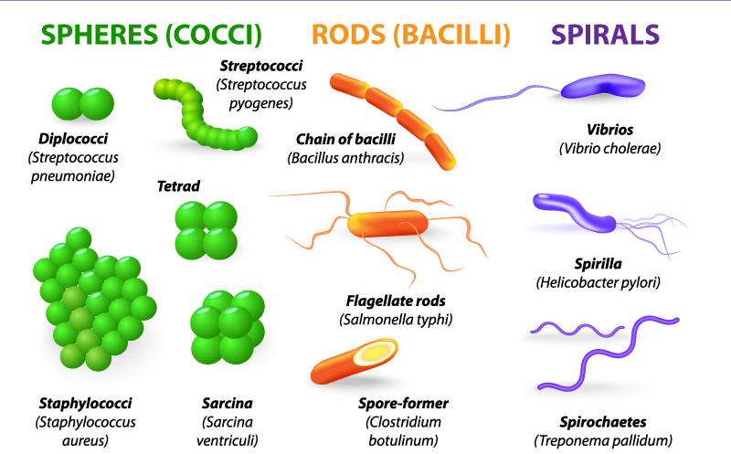
Shapes of Bacteria
https://laboratoryinfo.com/wp-content/uploads/2015/03/bacteria-types.jpg

Slide 6
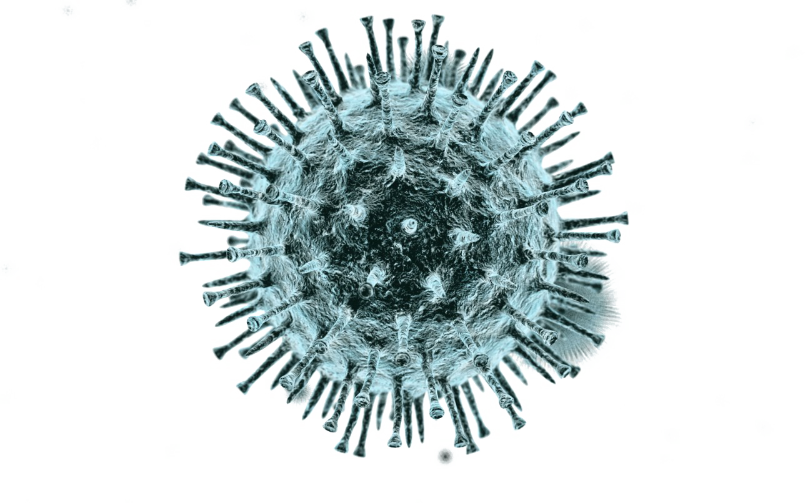
Viruses
Viruses are small pieces of genetic material surrounded by a protective shell.
Viruses can not move on their own
Viruses spread very quickly through the air, water, or physical contact
Viruses are even smaller than bacteria
https://th.bing.com/th/id/R.5de69edd29677393318c895e71ecd9d3?rik=29iAHCYw3N063Q&riu=http%3a%2f%2fwww.pngmart.com%2ffiles%2f6%2fVirus-PNG-Photo.png&ehk=ZVJ4%2bXKtgi11wA1A64%2bk2ssj5XGF7bpmX92%2fZbVSkZk%3d&risl=&pid=ImgRaw&r=0

Slide 7
Living or Nonliving?
All living cells need to contain genetic material, take in nutrients and reproduce.
Viruses do not take in any nutrients, and can not reproduce, meaning they are not technically alive
Viruses hijack cells and force them to make more copies of the virus.
Viruses can hijack humans, plants, animals, even bacteria

Slide 8
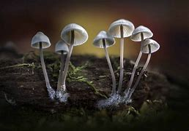
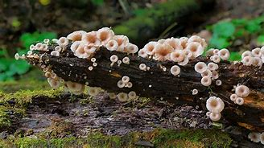
Fungi
The most commonly known Fungus are mushrooms
Others include: mold, mildew and yeast
Fungi can be microscopic to as big as 60 inches
Fungi get nutrients from dead plant or animal matter. This makes them decomposers.
Fungi create spores in order to create new organisms
https://th.bing.com/th/id/OIP.2zJkULRZzzs057IRx_prwgHaEK?w=328&h=184&c=7&r=0&o=5&pid=1.7 https://images6.alphacoders.com/103/thumb-1920-1033690.jpg

Slide 9
Activity
Materials
  2 Slices of bread
  2 Sealable plastic bags
  Tape
  Marker
  Spray bottle
Instructions:
Spray 3 squirts of water on each slice of bread.
Write “COOL” on one bag, and “WARM” on the other.
Add 1 piece of bread to each bag.
Close the bags and tape the seals airtight.
We are going to leave one bag in a cold place and one in a warm place for 3 days, and see what happens!

Slide 10
Day 2
Let’s Review what we learned during the last class
Today we are learning about our immune system and how it fights infections caused by microorganisms

Slide 11
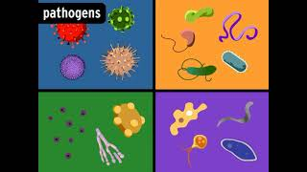

Slide 12
Let's think about COVID-19…
What do you remember about COVID-19?
How did COVID-19 spread?
How did we prevent the spread of COVID-19?
What are other ways disease can spread?
What are other ways to prevent diseases?

Slide 13
Day 3
What did we learn about last class period?
Today we are going to learn about some of the helpful microorganisms, mainly the ones in our gut.

Slide 14
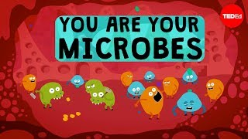

Slide 15
Gut Microbiome
The Bacteria that live in our intestines are essential in digesting food
Other species help with fermentation in the gut, the same process that produces foods such as yogurt and cheese
  Video: https://kids.britannica.com/students/assembly/view/171958
“There are up to 1,000 species of bacteria in the human gut microbiome, and each of them plays a different role in your body. Most of them are extremely important for your health, while others may cause disease”

Slide 16
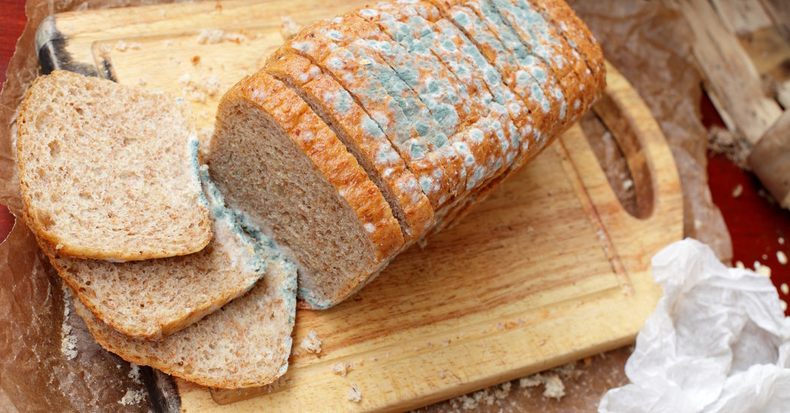
Activity - Conclusion
“Like bacteria, fungi are also microbes. Fungi include yeast, mushrooms, and mold. Cold temperatures slow the growth of microbes, which is why we have refrigerators. Things last longer in the fridge because bacteria and fungi grow slower in the cold. This is why the “COOL” bread doesn’t grow mold over a week, while the “WARM” bread does.”
https://archive.nytimes.com/well.blogs.nytimes.com/2015/10/29/ask-well-is-it-safe-to-eat-moldy-bread/

Slide 17
Sources

