Slide 1
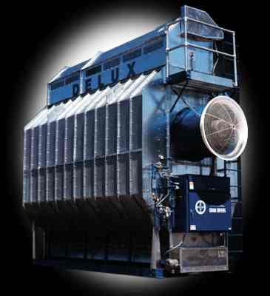
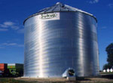

2009 Soybean Drying Tips
Kenneth Hellevang, Ph.D., P.E.
Professor & Extension Engineer
Agricultural & Biosystems Engineering
NDSU Extension Service

Slide 2

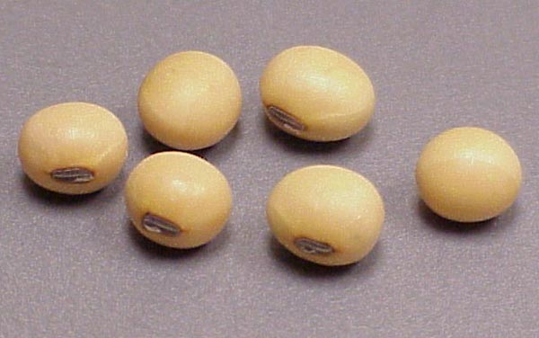
Soybeans
Week Ending | Oct. 11, 2009 | Oct. 4, 2009 | Oct. 11, 2008 | Average 2004-2008
 | Percent | Percent | Percent | Percent
Dropping Leaves | 98% | 93% | 100% | 99%
Harvested | 17% | 13% | 57% | 68%
USDA, NASS, ND

Slide 3
Maximum Moisture Contents for Safe Soybean Storage with Aeration
Sold by Spring 14% (13%)
Stored up to 1 year 12%
Long-term Storage 11%
EMC @ 70ºF & 60% RH
Corn 12.8%
Hard Wheat 13.3%
Soybeans 10.8%
Notes:
The long-term storage moisture content must be low enough to minimize mold growth. Generally the long-term storage moisture content is associated with a temperature of about 70 F and 60% relative humidity. For soybeans the equilibrium moisture content would be about 10.8%, which corresponds to the recommended 11% long-term storage moisture content. Generally listed moisture content for storage over winter is 14%, which exceeds the 13% market standard.

Slide 4

“Approximate” Allowable Storage Time for Cereal Grains (Days)
Moisture | ----- Grain Temperature (°F) -----
Content | 30º | 40º | 50º | 60º | 70º | 80º
(%) | Approximate Allowable Storage Time (Days)
14 | * | * | * | * | 200 | 140
15 | * | * | * | 240 | 125 | 70
16 | * | * | 230 | 120 | 70 | 40
17 | * | 280 | 130 | 75 | 45 | 20
18 | * | 200 | 90 | 50 | 30 | 15
19 | * | 140 | 70 | 35 | 20 | 10
20 | * | 90 | 50 | 25 | 14 | 7
22 | 190 | 60 | 30 | 15 | 8 | 3
24 | 130 | 40 | 15 | 10 | 6 | 2
26 | 90 | 35 | 12 | 8 | 5 | 2
28 | 70 | 30 | 10 | 7 | 4 | 2
30 | 60 | 25 | 5 | 5 | 3 | 1
Notes:
The allowable storage time (AST) of grain is affected by both the grain temperature and moisture content. Corn at 24% moisture content has an allowable storage time of about 130 days at 30ºF, 40 days at 40 degrees and only 15 days at 50 degrees. Therefore, the recommendation is to dry the corn in a high temperature dryer during February.
Corn at 22% moisture has an AST of about 190 days at 30 degrees, 60 days at 40 degrees, and 30 days at 50 degrees. Therefore, the recommendation is to dry the corn in a high temperature dryer by early March. Corn at moisture contents of 21% or less can be kept cold and natural air dried starting in April.
The value in the table is based on the grain temperature being at that value, so the grain must be aerated with air at the desired temperature at least periodically, to ensure that it remains at the temperature.
Allowable storage time is cumulative. If one-half of the AST is used at a temperature, there is only one-half of the time shown on the chart for the new temperature. For example if 22% moisture content corn is held at 50 degrees for 10 days then cooled to 30 degrees, the AST at 30 degrees is 127 days rather than the 190 days shown on the chart. The AST of 22% moisture corn at 50°F is 30 days. During the 10 days the corn is held at 50 degrees, 33% of the AST is used, 10/30=0.33. Therefore, the AST at 30°F is 67% of the time listed in the chart, 1.0 - 0.33=0.67. The AST at 30 degrees then is 127 days, 0.67 x 190.

Slide 5
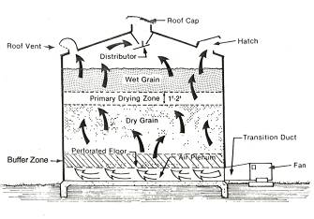
NA Drying Soybeans
October 47ºF & 65% RH EMC = 12.0%
 | cfm/bu | Drying Time (days)
18% | 1.0 | 58
 | 1.5 | 39
 | 2.0 | 29
16% | 1.0 | 50
 | 1.5 | 34
 | 2.0 | 25
October 15 – November 15 37ºF & 70% RH EMC = 13.7%
 | Cfm/bu | Drying Time (days)
18% | 2.0 | 36
16% | 2.0 | 39
April 42°F & 71% RH, May 56°F & 63% RH
Notes:
Soybeans can be natural air dried during October to about 12% moisture and from mid-October to mid-November to about 13.7% moisture. A minimum airflow rate of 1.5 cfm/bu is suggested for October drying and 2 cfm/bu for drying during late October and early November. High airflow rates are required due to the cool air temperature and large amount of moisture that needs to be removed from the soybeans.

Slide 6
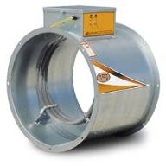
LT Drying Soybeans
October 15 – November 15 +5ºF
42ºF & 58% RH EMC = 11.0%
 | cfm/bu | Drying Time (days)
18% | 1.0 | 58
 | 1.5 | 39
 | 2.0 | 29
16% | 1.0 | 50
 | 1.5 | 34
 | 2.0 | 25
April 42°F & 71% RH, May 56°F & 63% RH
Notes:
Warming the air by 5 degrees reduces the final moisture content to 11%. An airflow rate of 1.5 cfm/bu should be considered the minimum. An airflow rate of 2.0 cfm/bu permits drying in 3 to 4 weeks. The higher airflow rates are possible due to the small static pressures associated with soybeans.

Slide 7
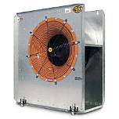
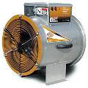
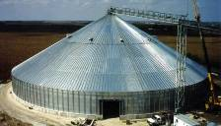
Fan Power Required
 | Soybean Depth (ft)
Airflow Rate | 16 | 18 | 20 | 22 | 24
(cfm/bu) | --- hp per 1,000 bu ---
1.0 | 0.5 | 0.6 | 0.8 | 1.0 | 1.2
1.25 | 0.8 | 1.0 | 1.3 | 1.6 | 2.0
1.5 | 1.2 | 1.6 | 2.0 | 2.5 | 3.1
2.0 | 2.4 | 3.1 | 4.0 | 5.1 | 6.3
Limit Depth
42 ft diameter bin, soybean 36 ft deep, 1.5 cfm/bu
Fan = 340 hp, static pressure = 21-inches wg.
Not feasible!
Notes:
Some people estimate the drying fan size needed using a rule of thumb of one horsepower per thousand bushels of corn. This is only true for an airflow rate of 1.0 cfm/bu and a corn depth of about 19 feet. It is best to use a fan selection program or tables to select the fan horsepower needed.
Many people desire to dry corn using a natural air and low temperature system on a tall bin. This is not feasible. For example, a 180 hp fan would be required to provide an airflow rate of 1.0 cfm/bu for a 42 ft. diameter bin of corn that is 36 ft. deep. Not only is the fan horsepower required not practical, but the operating static pressure would be about 17 inches, which exceeds the capability of common grain drying fans. The maximum depth of wet corn that can be realistically dried is about 22 ft.
The speed of drying is related to the airflow rate. Drying is too slow at low airflow rates to dry the grain before deterioration occurs. However, to double the airflow rate requires increasing the fan horsepower by a factor of 4 to 5. Therefore, high airflow rates are not practical because the fan horsepower required becomes excessive.

Slide 8
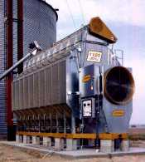
High Temperature Drying Soybeans
Some varieties split worse than others.
Initial moisture has no effect on splitting.
Avoid recirculating dryers.
Maximum Drying Temperature
(non-food soybeans)
Continuous flow 130°F
Batch Dryer 110°F
Seed 110°F
Relative humidity above 40% reduces cracks.
Notes:
General guidelines for high temperature drying soybeans are a maximum temperature of 130 degrees for a continuous flow dryer and 110 degrees for a batch dryer or when drying seed. Research shows that seed coat or seed breakage will occur at these drying temperatures.

Slide 9
Damage Occurring to Soybeans as Function of Drying Temperature
Drying Temperature (ºF) | Skins Cracked (%) | Beans Cracked (%)
100 | 10 – 60 | 5 – 20
130 | 50 – 90 | 20 – 70
160 | 80 – 100 | 30 - 80
Notes:
One study found that at 100 F 50-90% of the skins were cracked and 20-70% of the beans were cracked. Even at 100 F, there was considerable damage to the beans.

Slide 10
20ºF Temperature Increase Reduces Relative Humidity to ½ (80% 40%)
Soybean Seed Coat
Damage and Cleavage
Notes:
This study showed that bean cleavage (breakage) occurred at relative humidities below 30% and seed coat cracking was about 50% at 20% relative humidity and about 30% at 30% relative humidity. Keep the relative humidity of the drying air above about 30% to maintain the integrity of the seed and seed coat. Since a 20 degree increase in temperature reduces the relative humidity to one-half, very little heat can be added when drying high value beans. Air at 80% RH will have a RH of 40% when heated 20 degrees.

Slide 11
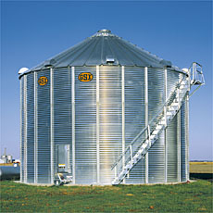
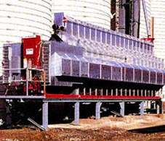

For More Information
http://www.ag.ndsu.nodak.edu/abeng
Google: NDSU Corn Drying
Notes:
More information is available on the web at http://www.ag.ndsu.nodak.edu/abeng. The web site can be found by doing a internet search for NDSU corn drying.

